Slide 1

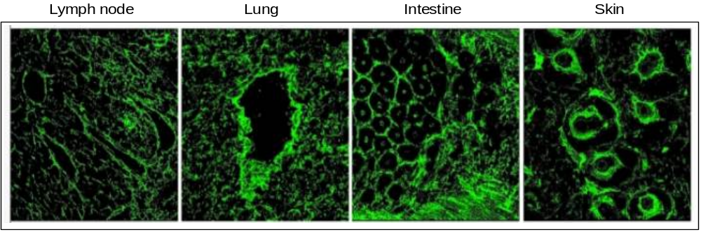
ReliaTech GmbH
Immunofluoresence with anti-mouse Emilin-1 (clone #C11A8)
(Cat #103-M80)
FIG. 1. EMILIN1 is expressed in association with lymphatic vessels. Cryostat sections of normal mouse tissues stained with anti-EMILIN1 (green) antibodies. In all mouse tissues and organs examined, EMILIN1 was uniformly distributed in the stroma. In the skin, EMILIN1 staining colocalizes with LYVE-1-positive lymphatic vessels surrounding hair follicles. In the small intestine, EMILIN1 colocalizes with LYVE-1-positive lacteals and submucosal lymphatic vessels. At higher magnification, in the lung and lymph nodes, it is more evident that EMILIN1 is distributed at the abluminal surfaces of LECs . In the lymph node, EMILIN1-positive fibers connecting LECs to the surrounding ECM are evident.
http://www.reliatech.de / orders@reliatech.de

